Slide 1
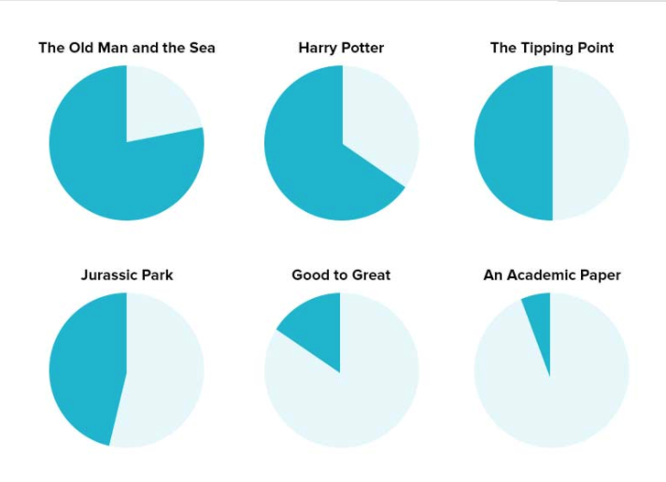
% of Americans who can read the following…
Notes:
Ernest Hemingway
J. K. Rowling
Malcolm Gladwell
Michael Crichton
James C. Collins
https://contently.com/strategist/2015/01/28/this-surprising-reading-level-analysis-will-change-the-way-you-write/

Slide 2
(Last week, CH 5)
Innovations That Fit
Focus innovation on enhancing core competencies (business model, markets, technologies essential to compete)
  Can be limiting/ miss opportunities; or
  Going outside your competencies could be disastrous
Notes:
Famous Amos – Wally Amos – The Cookie Kahuna

Slide 3

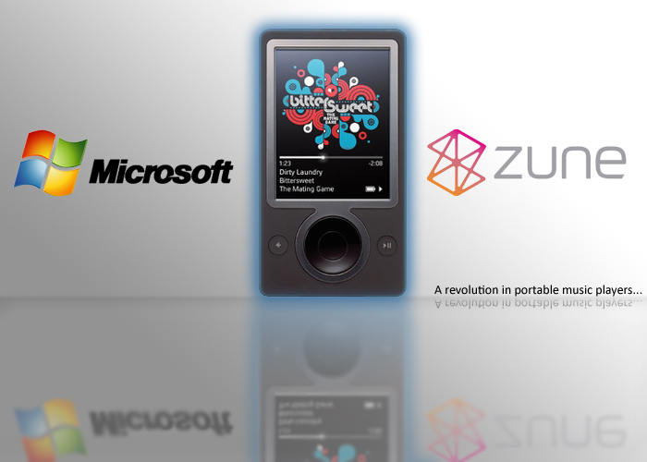
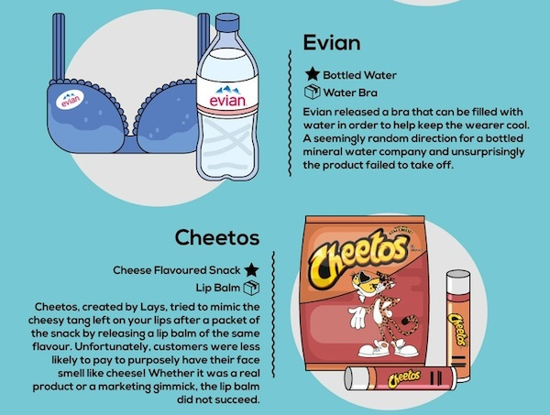
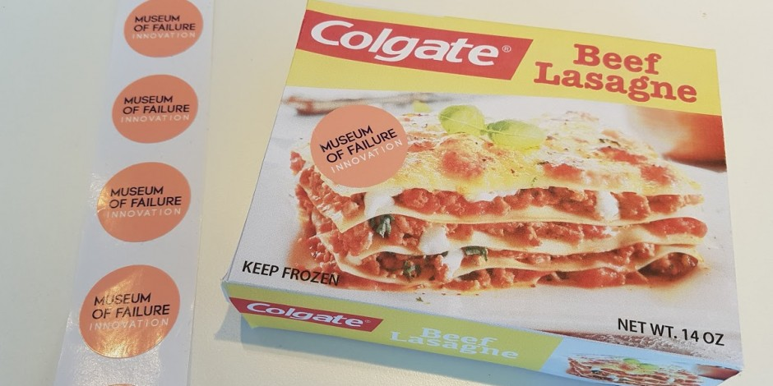



Innovations that fit (CH 5) – or don’t

Slide 4

failuremuseum.com
Notes:
http://failuremuseum.com/

Slide 5
Virgin (failed) Examples
Student magazine (1968)
Virgin Games (1981)
Virgin Cola (1994)
Virgin Vodka (1994), pre-mix drink, energy drink … Virgin Vine is still going under new ownership x2
Virgin Brides wedding dresses (1996)
Virgin Vie cosmetics (1997)
Virgin Clothing (1998)
Virgin Cars online auto sales (2000)
VirginStudent social network (2000)
Virginware lingerie (2003)
Virgin Pulse & Virgin Digital (2004) vs iPod & iTunes
On the closing of the last Virgin Megastore (1992-2009):
“the scale of the losses meant that we had to sell the business to its management and focus our attention on markets where we could be the disrupter, not the disrupted”

Slide 6
Sticking to your competencies doesn’t always work either
Home Depot – China, Turkey
Walmart – Germany, South Korea, Japan, India, Russia
Starbucks – Australia, Israel
Best Buy – UK, China
Target – Canada
Carrefour – Thailand, Malaysia, Russia, USA
McDonald’s – Caribbean, Macedonia, Iceland, Bolivia, McPizza

Slide 7
Illuminating the Pathway: How to Measure Innovation
Chapter 6

Slide 8
M.I.W. Chapt. 6: How to Measure Innovation
What gets measured gets done – so be careful what you measure
Measurement is one of the most critical elements of success in innovation. When measurement systems are not aligned with the strategy and not tailored to the portfolio’s mix of incremental, semi-radical, and radical innovation, managers lose a key source of information.
Financial & non-financial measurements

Slide 9
How to Measure Cont.
Understand strategy and business model innovation for your company, and build a measurement system for innovation that is tied to both.
Know what you want to achieve with each measurement system at each level of the organization.
Tailor the innovation-measurement system to match the mix of incremental, semi radical and radical innovative strategies.
Change your measurements as your strategy and organization change.
Build your innovation measurement system to avoid the seven barriers (pp. 176-179).

Slide 10
3 Roles of a Measurement System
Plan: define and communicate strategy
  Clear & explicit expectations of the strategy
Monitor
  Track execution of innovation efforts, evaluate performance
Learn: identify new opportunities
  Learn new solutions to achieve performance goals, new business, or tech opportunities

Slide 11
Figure 6.1 Three roles of measurement systems (p.150)
Top Management Team
Communicate Monitor Learn
Organization

Slide 12
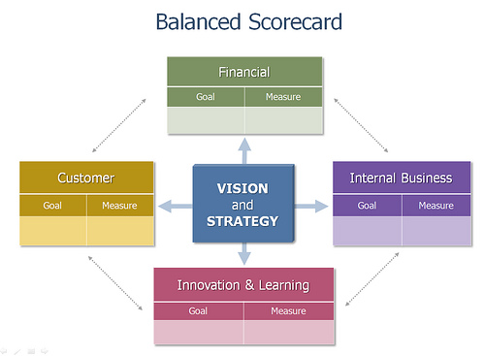
Balanced Scorecard Approach to Measuring Innovation

Slide 13
A Business Model of Innovation
Input
Process
Output
Outcome

Slide 14
A Business Model of Innovation
Input
Inputs are the resources devoted to the innovation effort. Different types of inputs include:
Tangible resources – capital, time, software, physical infrastructure
Intangibles – talent, motivation, culture, knowledge, brands
Innovation structure – interest groups and corp. venture capital
Innovation strategy – Innovation platforms, position in Innovation Matrix
External network – partners, customers, suppliers
Innovation systems – systems for recruiting, training, execution and value creation

Slide 15
A Business Model of Innovation
Process
Combine inputs and transform them:
Creative process – tracks the quality of ideas, the ability to explore them, and the conversion rate into projects & value.
Project execution – tracks the evolution of projects currently underway.
Integrated execution – tracks aggregate performance of all projects
Balance innovation portfolio – tracks the mix of projects within Innovation Matrix and its alignment with strategy

Slide 16
A Business Model of Innovation
Outputs
The results of the innovation efforts in terms of quality, quantity and timeliness: (don’t forget customer satisfaction)
Technology leadership – patents, licenses, seminars, citations
Project completion – execution metrics
New product introduction – # of successful products, acceptance compared to competitors, market share, and sales
Business processes improvement – process metrics
Market Leadership – customer acquisition, share, loyalty

Slide 17
A Business Model of Innovation
Outcomes
Describe value creation in terms of share price or residual income (RI= profits - capital employed X cost of capital):
Project Profitability – value generated during lifecycle
Customers and products profitability – overall value of innovation from market/product perspective
Return on investment – current profitability of org.
Long-term value captured – through life of product/product family

Slide 18
From Business Model to Measurement System
-refer to figure 6.4 & 6.5 on pages 155-7
-table 6.2 pages 173-5 has extensive list of measures
Input
Process
Output
Outcome

Slide 19
Measures for Ideation
The flow of ideas which fuel innovation depends on the ability to leverage Human Capital.
Parts of the Human Capital Equation
  Culture
  Exposure to Innovation Stimuli
  Understanding of innovation strategy
  Management infrastructure for ideation.

Slide 20
Examples of Measurements of Human K
Peer assists
Peer groups
Federal groups
Talent
Money
Knowledge
Management systems
Communication

Slide 21
7 Barriers to Effective Performance Measurement
Wrong execution model
Wrong measures
Ignored subjective measures
Limited information tech capabilities
Over-reliance on “facts”, not enough “learning”
Wrong role for the system
Wrong data into the system

Slide 22
Measurement & the Innovation Rules
Directly link the innovation measures to the innovation strategy and the innovation business model.
Don’t be rigid; build enough variability to allow valuable measurement.
Know the specific purpose of each type of measurement system; trying to achieve too many objectives will get you nowhere.
KISS principle (keep it simple, stupid)
Stay in charge

Slide 23

Tom Peter’s Simple method of Measurement!
Notes:
https://www.youtube.com/watch?v=k2iymNBSabc

Slide 24
What is Creativity?
Creativity is a modifiable, deliberate process that exists to some degree in each of us. It proceeds through an identifiable process and is verified through the uniqueness and utility of the product created.
Donna Y. Ford, J. John Harris in ‘The Elusive Definition of Creativity’

Slide 25
Creativity As Defined by Students
“Creativity means to invent or create something.”
“Creativity means to do something very unique and different form what others have done.”

Slide 26
Guilford’s View of Creativity (1950)
Creativity is a set of traits.
Creativity should be stable.
Reliability of creativity tests will be low.
Completion tests are needed to measure creativity.
Creativity-test scores will show little correlation with intelligence-test scores.
Creative performance depends on more than creativity.
Creative abilities are continuously distributed.

Slide 27
Can We Teach Creativity?
Torrance and his graduate students analyzed the effectiveness of 142 experiments designed to facilitate creative growth.
They found that “rarely have any of the methods tested failed to produce measurable, statistically significant creative growth…the greatest growth occurs when creative problem solving is taught”.

Slide 28
Some Tools To Enhance Creativity
SCAMPER – the acronym for “substitute, combine, adapt, modify (e.g., magnify or minify), put to other uses, eliminate, reverse’
- Technique #19 from toolkit
- a set of directed questions to help you evolve your existing product, service or solution into one that is superior

